Slide 1
Experiential Learning Phase -I :
OPERATING SYSTEMS
Virtual Memory Profiler
Team Introduction
Shreyashwini R 1RV22CS192
Siri H 1RV22CS198
Vijayshree V M 1RV22CS232

Slide 2
PRESENTATION CONTENTS
Problem Statement
Introduction and Relevance
Methodology
Literature Survey
Tools/APIs Used
Applications
Implementation
Conclusion

Slide 3
Problem Statement
Develop a Virtual Memory Profiler that can monitor, analyze, and optimize the virtual memory usage of software applications.
The profiler should be capable of identifying memory leaks, inefficient memory allocation, and excessive page swapping, providing valuable insights for developers and system administrators to enhance the performance of their applications.
The goal of this project is to develop a Virtual Memory Profiler that can analyze and optimize the utilization of virtual memory in software applications.
The main aim of this project is to create the virtual memory profiler that generates detailed reports on memory usage patterns.
Profiling the virtual memory behavior during different stages of application execution.

Slide 4
INTRODUCTION AND RELEVANCE
A Virtual Memory Profiler is a vital tool for analyzing and optimizing the utilization of virtual memory in software. It provides insights into memory usage patterns, potential leaks, and optimization opportunities.
By offering developers a detailed view of virtual memory management, the profiler enhances program performance, minimizes system crashes, and promotes efficient resource use. Additionally, it serves as an educational resource, helping developers understand the complexities of virtual memory management for creating more robust software systems.
Creating a memory profiler in C holds significant relevance for software development, offering essential benefits in debugging, optimization, and resource efficiency. Such a tool aids in identifying and rectifying memory-related issues early in the development process, leading to improved program performance and reduced system downtime.
The project's cross-platform compatibility, educational value, customization options, and potential for open source contribution further enhance its significance.
Ultimately, this memory profiler contributes to the overall quality and reliability of software, addressing real-world challenges faced by developers and organizations.

Slide 5
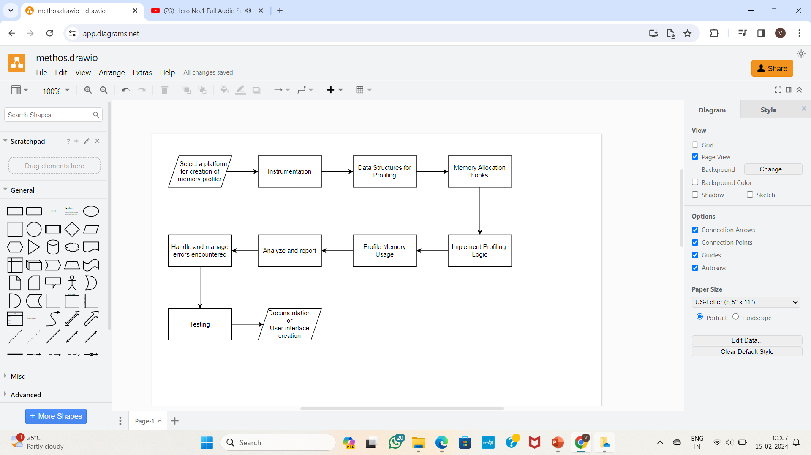
Methodology

Slide 6
Literature Survey
Author | Paper/Book Title | Publication Details | Summary
R.W.Doran | Virtual Memory | Published in: Computer ( Volume: 9, Issue: 10, October 1976) Page(s): 27 - 37 Date of Publication: October 1976 ISSN Information: DOI: 10.1109/C-M.1976.218408 Publisher: IEEE | "Virtual memory" is a computing term which has come into increasing use in recent years. Unfortunately, like other new expressions, its use often causes controversy and misunderstanding, for it is used to mean different things by different people. Not long ago when one major computer vendor announced the introduction of the new technique of 'virtual storage,' other manufacturers complained that they had been doing the same thing for years under a different name
Gajanan Digambar Gaikwad | Refresh Rate Identification Strategy for Optimal Page Replacement Algorithms for Virtual Memory Management | International Journal for Research in Applied Science and Engineering Technology ◽ 10.22214/ijraset.2021.38770 ◽ 2021 ◽ Vol 9 (11) ◽ pp. 166-16 | Operating system offers a service known as memory management which manages and guides primary memory. It moves processes between disk and main memory during the execution back and forth. The process in which we provisionally moves process from primary memory to the hard disk so the memory is available for other processes. This process is known as swapping.

Slide 7
Tools/APIs Used
System Calls
fopen: Opens a file descriptor for the /proc/{pid}/status file.
fclose: Closes the file descriptor.
getrusage: Retrieves resource usage information for the current process.
getrlimit: Gets the current or maximum value for a specific resource limit.
The getrusage system call retrieves resource usage information for the current process (itself). This includes peak heap memory usage.
The getrlimit system call retrieves the current limit for the stack size of the process.
Functions:
The sscanf function scans specific lines for desired information:
VmSize: %ld kB: Extracts the virtual memory size of the process.
VmRSS: %ld kB: Extracts the resident set size (physical memory usage) of the process.
majflt: %d: Extracts the number of major page faults incurred by the process.
Struct rusage is a structure used to represent resource usage statistics. It contains various fields, including ru_minflt and ru_majflt, which represent the number of minor and major page faults.

Slide 8
Applications
Software Development:
Memory Leak Detection: Identifying and resolving memory leaks in software applications during the development phase.
System Monitoring and Performance Tuning:
Real-time Analysis: Continuously monitoring virtual memory metrics to identify performance bottlenecks and optimize system responsiveness.
Performance Profiling for Applications:
Application-specific Profiling: Profiling virtual memory for specific types of applications such as databases, web servers, or scientific computing applications.
Cross-Platform Development:
Compatibility Testing: Profiling virtual memory across different operating systems and platforms to ensure compatibility and optimal performance.

Slide 9
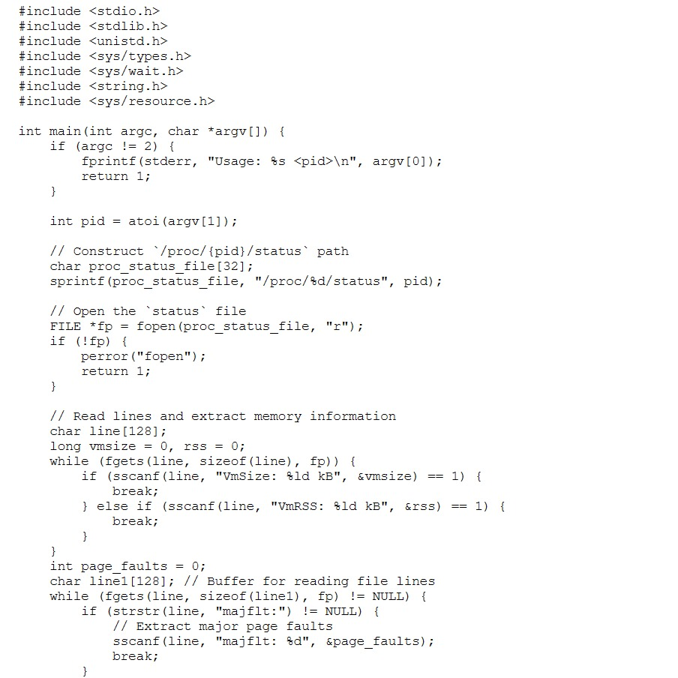
code

Slide 10
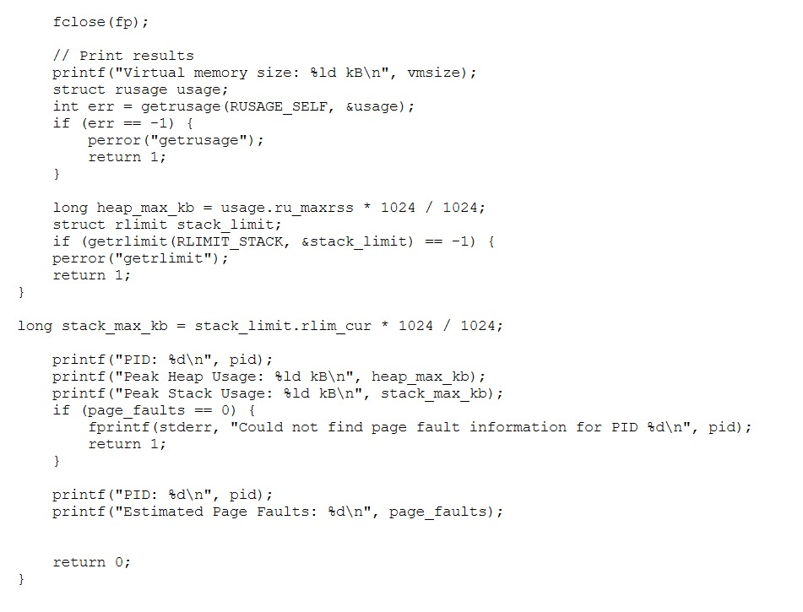
code

Slide 11
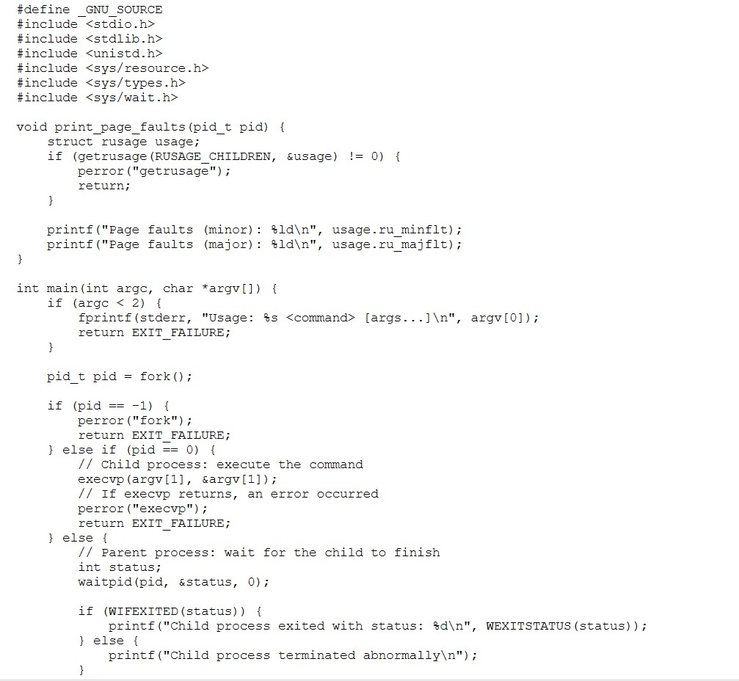
code

Slide 12
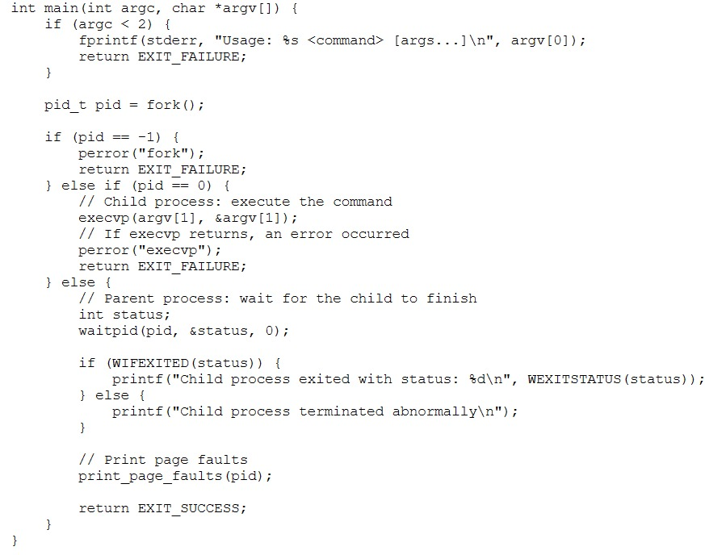
code

Slide 13
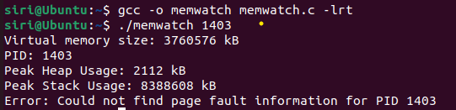
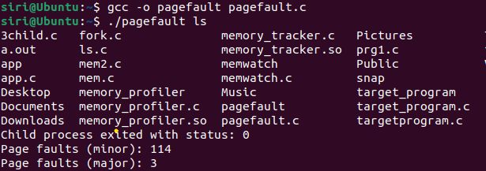
OUTPUT

Slide 14
Different system calls and functions used :
sprintf: This function formats and stores a series of characters and values in the command array, constructing the command to read the process's memory maps. It's used to generate the command string.
popen: This function opens a pipe to execute a shell command (cat /proc/{pid}/maps) and returns a stream that can be used to read the output of the command. It's used to execute the command and read the memory mapping information.
fgets: This function reads a line from the stream (fp) and stores it into the line buffer. It's used to read the output of the command line by line, representing memory mapping information.
printf: This function prints formatted output to the standard output. It's used to print memory mapping information to the console.
pclose: This function closes the pipe (fp) associated with the command, ensuring that the command execution is complete and releasing any resources associated with it.
atoi: This function converts a string argument (argv[1]) to an integer (pid_t pid). It's used to extract the process ID from the command-line argument

Slide 15
Memory Mapping Information
#include <stdio.h>
#include <stdlib.h>
#include <unistd.h>
#include <string.h>
void check_memory_maps(pid_t pid) {
char command[128];
FILE *fp;
// Construct the command to read the process's memory maps
sprintf(command, "cat /proc/%d/maps", pid);
// Open a pipe to read the output of the command
fp = popen(command, "r");
if (!fp) {
perror("popen");
exit(1);
}

Slide 16
char line[256];
while (fgets(line, sizeof(line), fp)) {
// Print the memory mapping information
printf("Memory Mapping Information (PID %d):\n%s", pid, line);
}
// Close the pipe
pclose(fp);
}
int main(int argc, char *argv[]) {
if (argc != 2) {
fprintf(stderr, "Usage: %s <pid>\n", argv[0]);
return 1;
}
// Get the process ID from command line argument
pid_t pid = atoi(argv[1]);
// Check for memory leaks in the specified process
check_memory_maps(pid);
return 0;
}

Slide 17
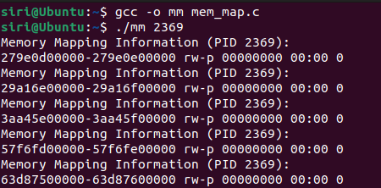
OUtPUT
Ohk..what about conclusion..no need leave it anything else?

Slide 18
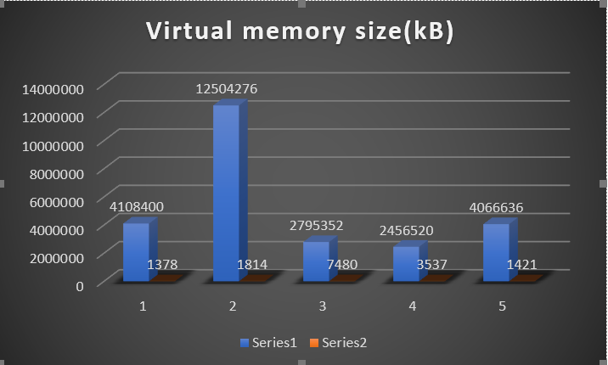
User Interface

Slide 19
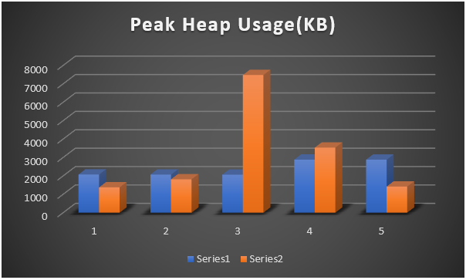
User Interface

Slide 20
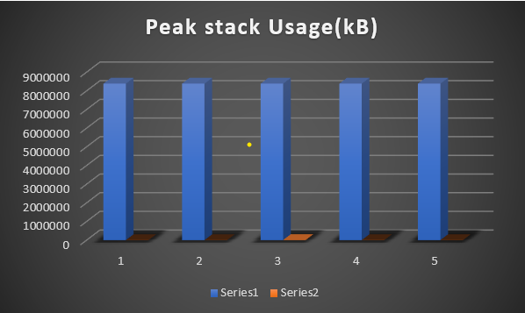
User Interface

Slide 21
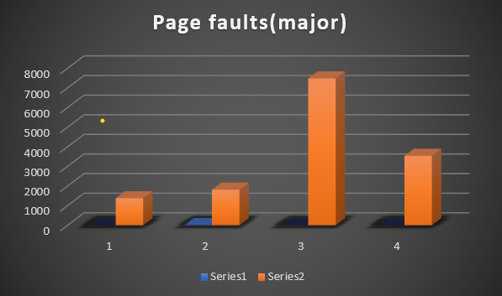
User Interface

Slide 22
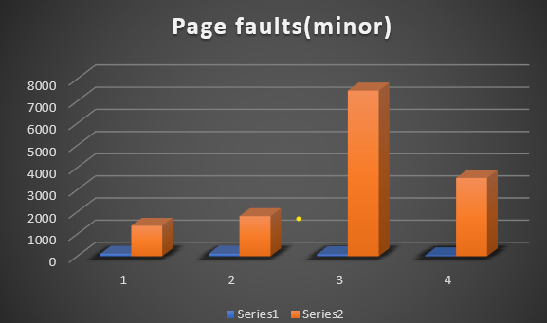
User Interface

Slide 23
conclusion
In conclusion, a Virtual Memory Profiler (VMP) is a valuable tool for analyzing and optimizing memory usage within virtualized environments.
By providing insights into memory allocation, page swapping, resource contention, and memory access patterns, VMP empowers users to identify inefficiencies, detect memory-related issues such as leaks or contention, and improve overall system performance.
Through real-time monitoring, historical analysis, and customizable alerting mechanisms, VMP enables proactive management of memory resources, helping to prevent downtime, enhance application responsiveness, and optimize resource utilization.
With its ability to integrate with virtualization platforms and provide customizable reporting and visualization features, VMP offers a comprehensive solution for effectively managing memory in virtualized environments, ultimately contributing to the stability, scalability, and efficiency of modern computing infrastructures.

Slide 24
THANK YOU

